Slide 1
Facial Recognition
BY:
Syed Ameen

Slide 2
INTRODUCTION:
Face recognition system is an application to verify a persons identity by comparing pictures taken recently from a digital camera or VCR , and
compare with the images stored in the system database.
Face recognition system has been widely used in recent years for security and access control,
like other security system that rely on biometrics such as fingerprint or eye IRIS

Slide 3




SOME TRAINING AND VALIDATION IMAGES :
TRAINING SET:
VALIDATION SET:

Slide 4
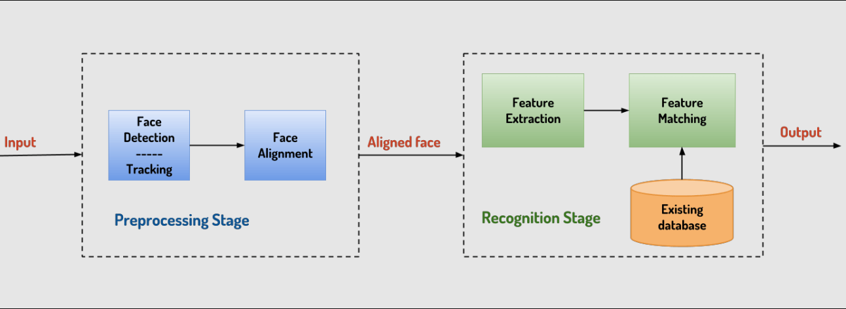
Process:

Slide 5
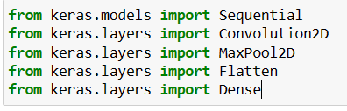
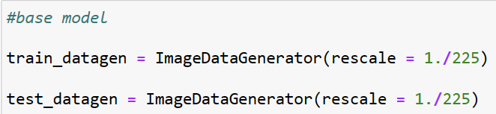
Libraries and model type
Create CNN Deep learning model

Slide 6
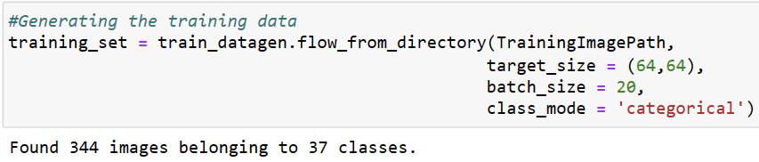
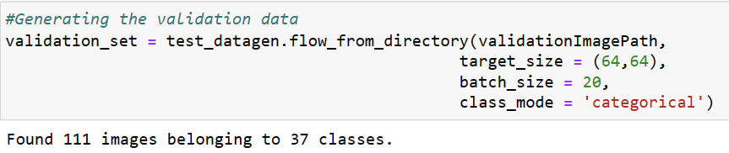
Generating the training data:
Training Data:
Validation Data:

Slide 7
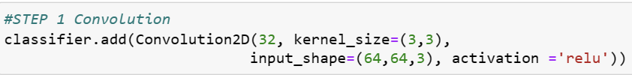




Proceeding with model:
Step 1 : Convolution
STEP 2- Max Pooling
# Additional layer of convolution for better accuracy
STEP 3- Flattening
STEP 4 - Fully connected neural network

Slide 8
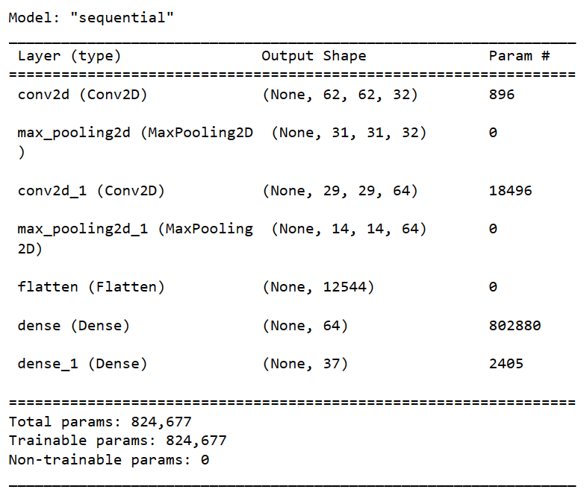
SUMMERY:
CNN Architecture design(1)

Slide 9
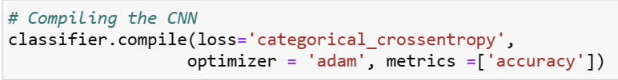
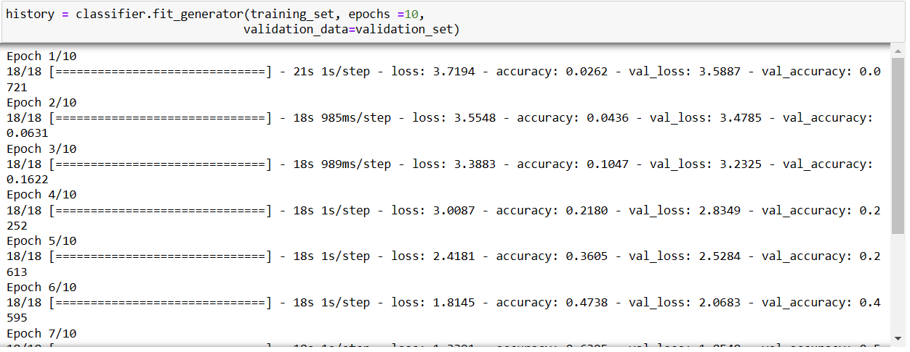
Model Training(1)
Execution of model:

Slide 10
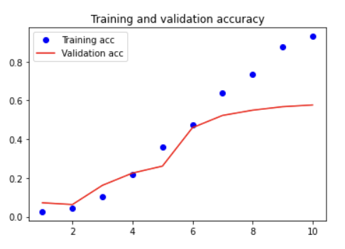
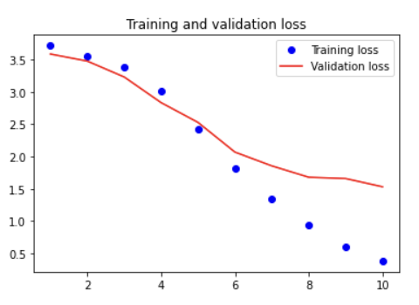
Model Evaluation
Accuracy base model:
Loss base model:

Slide 11

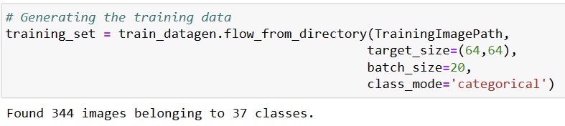
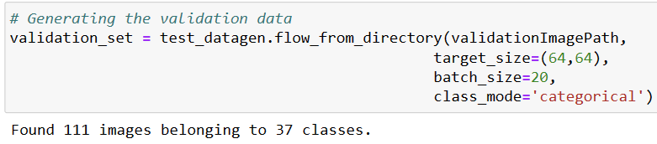
Adding parameters in the Image Data generator
Generating the training data
Generating the validation data

Slide 12
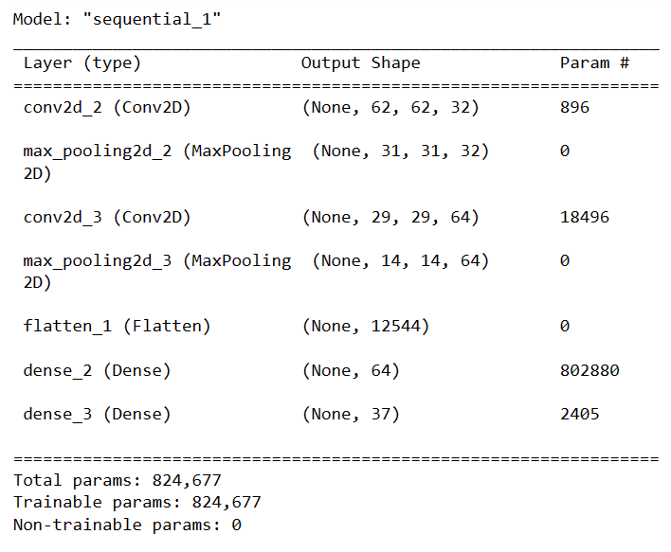
CNN Architecture design(2)

Slide 13
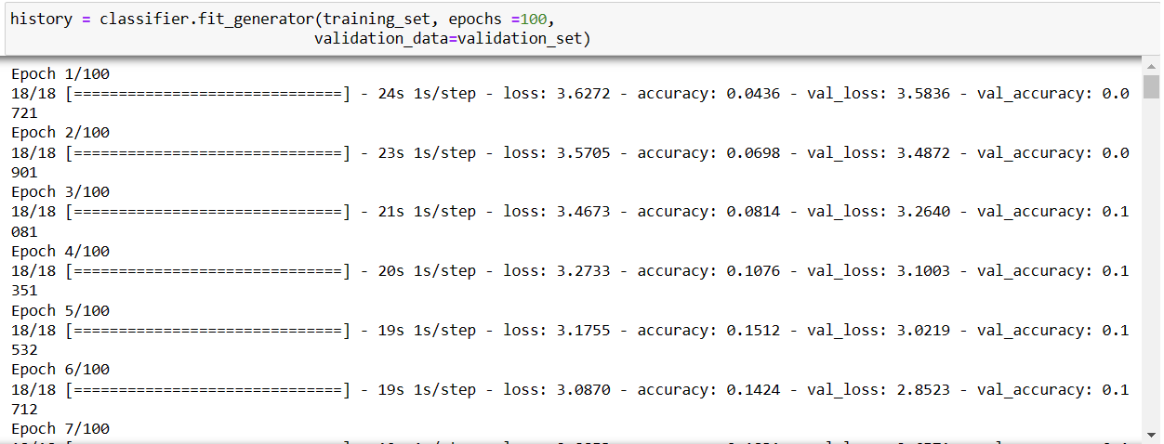
Model Training(2)

Slide 14
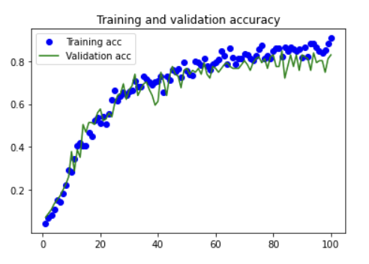
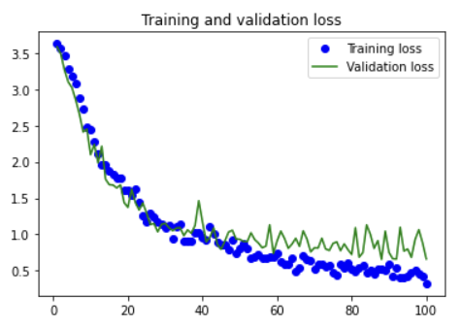
Model Evaluation
Accuracy base model:
Loss base model:

Slide 15
CONCLUSION:
Face recognition technologies have been associated generally with very costly top secure applications
Certain applications of face recognition technology are now cost effective, reliable and highly accurate
As a result there are not that much of noise in the training and validation set se we get almost 86% of accuracy of our model

Slide 16


